Slide 1
Data science course
Final Project
Presented by:
Adel Altuwaijri

Slide 2



Problem & Dataset
Exploratory Data Analysis
Machine Learning Models
Conclusions

Slide 3
The Problem
Can we expect the final grades for students ?
Can we classify the students at risk in passing a course from the given data ?
What are the relevant features required to classify the final grade outcome ?

Slide 4

DATASET
Structured raw dataset available at UCI ML Repository .
(rows=1044, columns=33)
Portuguese school collated student reports and questionnaires
Convert dependent variable final grade G3 to categorical

Slide 5
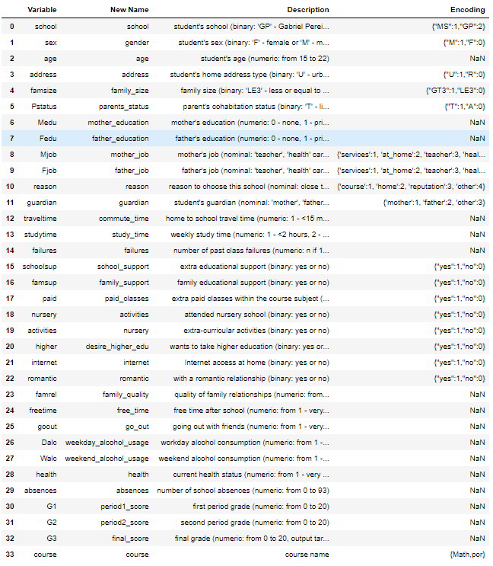
Shape
Rows : 1044
Columns: 33
Data Types
Object : 13
Numeric: 20
No Nulls
No Duplications

Slide 6
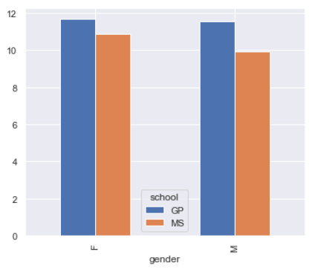
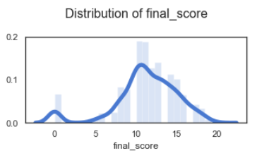
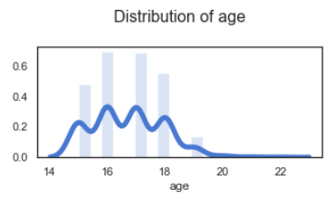
Distribution of Final Scores

Slide 7
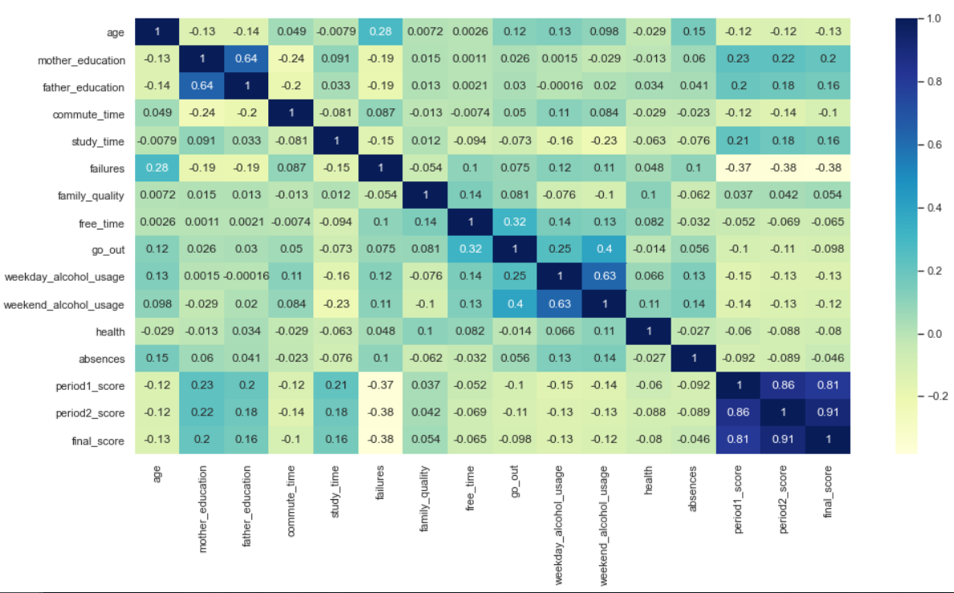
Correlation Matrix

Slide 8
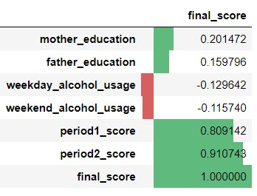
Collinearity

Slide 9
Data Manipulation
Data Pre-processing
Features Selection

Slide 10
Data Pre-Processing
Ordered categories
No chages
Encoded with sensible numeric values
Unordered categories
Dummy encoding (0/1)

Slide 11
Feature Selection
SelectKBest
f_regression ( Regression )
chi2 ( Classification )
Most important predictors
f_regression
chi2
- course_por
- desire_higher_edu_yes
- failures
- mother_education
- period2_score
- school_MS
- study_time
- weekday_alcohol_usage
- absences
- course_por
- failures
- father_job_teacher
- mother_education
- period2_score
- school_MS
- study_time

Slide 12
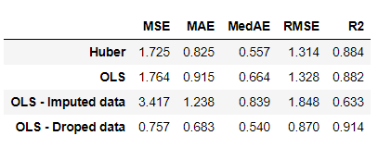
Linear Regression
Training and Testing ratio of 75:25
Target variable (categorical)
- Whether a student is likely to pass the final exam .
Resulting Metrics
Robust Regressor ( Huber )

Slide 13
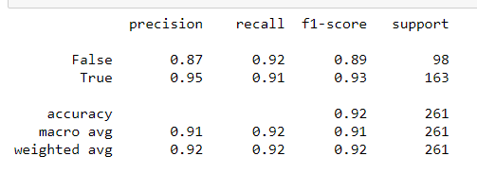
Logistic Regression
Target variable (categorical)
- Whether a student is likely to pass the final exam .
Classification Report
for all students who classified "PASS", 96 percent was correct
for all students who were actually "PASS", 96 percent was classified correctly

Slide 14
Conclusions

